Slide 1

EMPLOYEE MANAGEMENT
SYSTEM
Prepared by:
Sahil Sawant
(Batch #361)
Mentored by: Manisha

Slide 2
About me:
Background ?
Bachelor of Engineering (Mechanical)
Why did we want to learn Data Science?
As a working professional in the purchase departments, I had to deal with large amount of data on daily basis.
Given my profile, I had to make data driven decisions for a smooth functionality of supply chain.
This hands-on exposure gradually ignited my interest in understanding how data could be leveraged more efficiently and intelligently.
These experiences helped me in finding my passion in this profession.
Any work experience?
Sahil Sawant: 2+ Years Experience as Design and Purchase Engineer
Share your LinkedIn and GitHub profile URLs:
LinkedIn : http://www.linkedin.com/in/sahil-sawant-0a13371b1/
GitHub: https://github.com/sawantsahil19

Slide 3
Objective of the Project:
Purpose:
This project aims to design and analyze an employee management system using a relational database. It helps track employee details, qualifications, payroll, and leave records efficiently, enabling better HR and departmental decision-making.
Tools Used:
MySQL
PowerPoint
Data Source:
CSV files

Slide 4
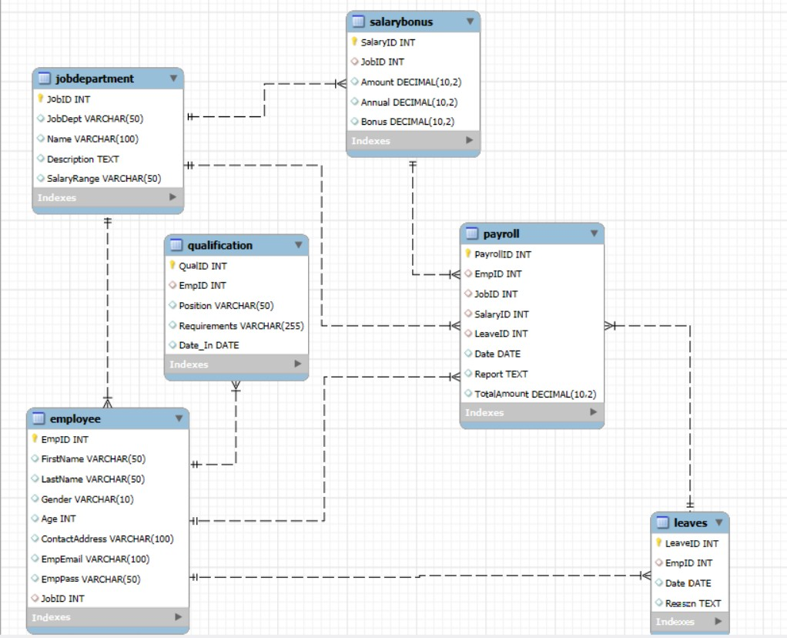
ER Diagram and Schema Explanation:
Correlation:
This ER diagram represents the structure of an Employee Management System database.
Includes key entities like Employee, Job Department, Qualification, Payroll, Leaves, and Salary Bonus.
Relationships are established using foreign keys to link employee data with job roles, payroll, and leave records.

Slide 5
Key Analysis Questions:
EMPLOYEE INSIGHTS
JOB ROLE AND DEPARTMENT ANALYSIS
QUALIFICATION AND SKILLS ANALYSIS
LEAVE AND ABSENCE PATTERNS
PAYROLL AND COMPENSATION ANALYSIS
EMPLOYEE PERFORMANCE AND GROWTH

Slide 6

1) Employee Insights:
1.1 How many unique employees are currently in the system?
Query:
Output:

Slide 7
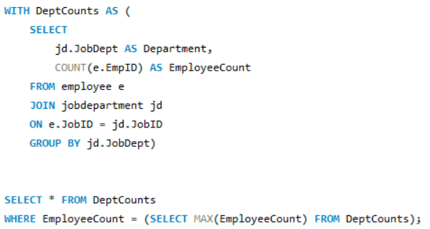

1.2 Which departments have the highest number of employees?
Query:
Output:

Slide 8
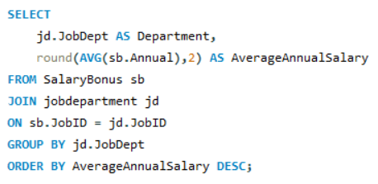
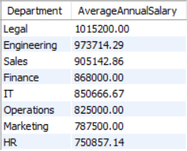
1.3 What is the average salary per department?
Query:
Output:

Slide 9
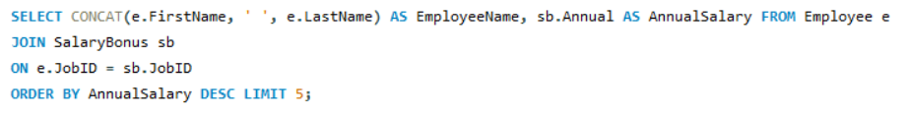
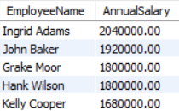
1.4 Who are the top 5 highest-paid employees?
Query:
Output:

Slide 10

1.5 What is the total salary expenditure across the company?
Query:
Output:

Slide 11

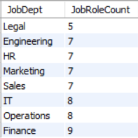
2) JOB ROLE AND DEPARTMENT ANALYSIS:
2.1 How many different job roles exist in each department?
Query:
Output:

Slide 12
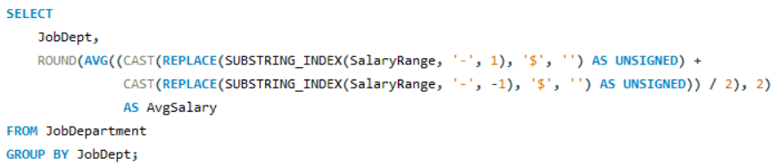
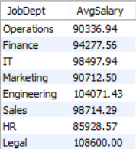
2.2 What is the average salary range per department?
Query:
Output:

Slide 13
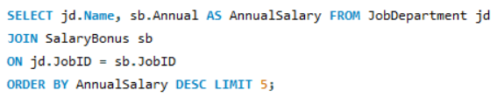
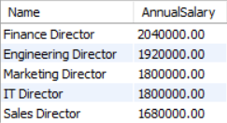
2.3 Which job roles offer the highest salary?
Query:
Output:

Slide 14
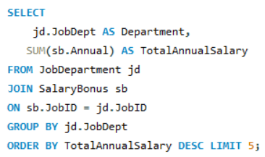
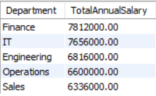
2.4 Which departments have the highest total salary allocation?
Output:
Query:

Slide 15

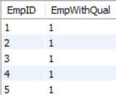
3) QUALIFICATION AND SKILLS ANALYSIS:
3.1 How many employees have at least one qualification listed?
Query:
Output:

Slide 16
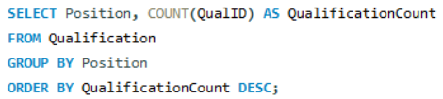
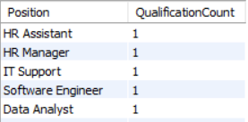
3.2 Which positions require the most qualifications?
Query:
Output:

Slide 17
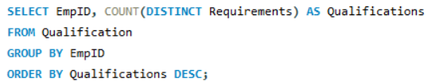
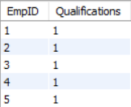
3.3 Which employees have the highest number of qualifications?
Query:
Output:

Slide 18
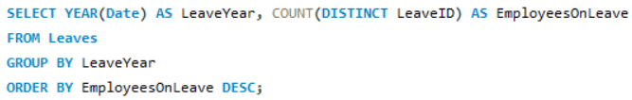

4) LEAVE AND ABSENCE PATTERNS:
4.1 Which year had the most employees taking leaves?
Query:
Output:

Slide 19
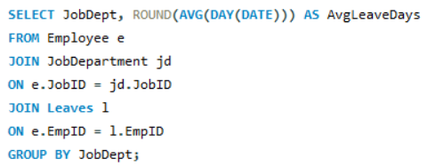
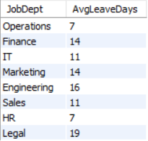
4.2 What is the average number of leave days taken by its employees per department?
Query:
Output:

Slide 20
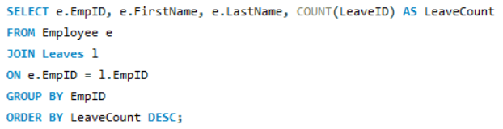
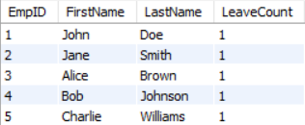
4.3 Which employees have taken the most leaves?
Query:
Output:

Slide 21

4.4 What is the total number of leave days taken company-wide?
Query:
Output:

Slide 22
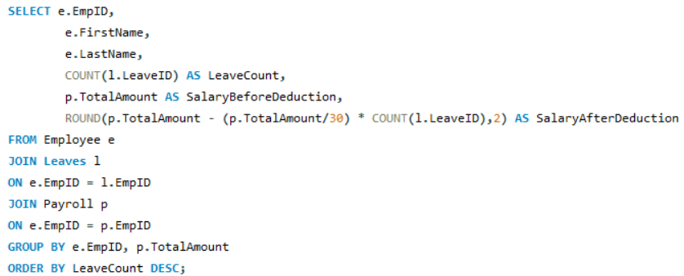
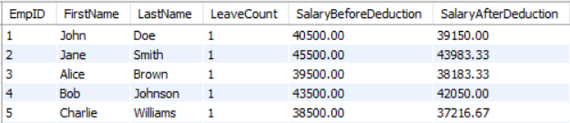
4.5 How do leave days correlate with payroll amounts?
Query:
Output:

Slide 23

5) PAYROLL AND COMPENSATION ANALYSIS:
5.1 What is the total monthly payroll processed?
Query:
Output:

Slide 24
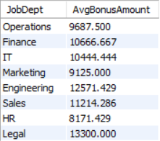
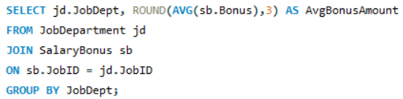
5.2 What is the average bonus given per department?
Query:
Output:

Slide 25
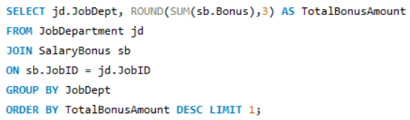

5.3 Which department receives the highest total bonuses?
Query:
Output:

Slide 26
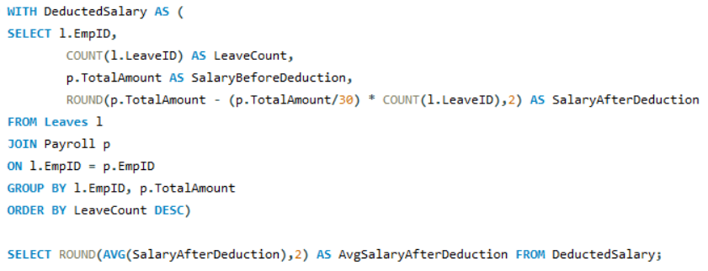

5.4 What is the average value of total_amount after considering leave deductions?
Query:
Output:

Slide 27
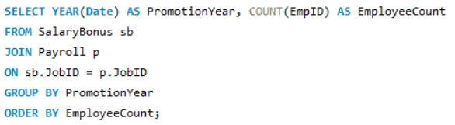

6) EMPLOYEE PERFORMANCE AND GROWTH:
6.1 Which year had the highest number of employee promotions?
Query:
Output:

Slide 28
Key Business Insights:
Departments like Finance and IT have the highest employee count, indicating strong reliance on these functions. Certain departments like Legal have fewer employees, possibly indicating limited scope or need.
Departments like Legal and Engineering have the highest average salaries in the company.
The company spends approximately $52 million annually on employee salaries.
The year 2024 saw the highest number of leave records with majority of leaves taken by employees from the Legal, Engineering, and Marketing departments.
A clear negative correlation can be seen between Leave Count and Take-Home Salary.
Bonuses are concentrated in specific departments like Finance and IT. This can indicate performance-based rewards or retention efforts.

Slide 29
Conclusion:
This project effectively demonstrates how a company's employee; their job roles, qualification, bonus, leave and payroll data can be managed and analyzed using a relational database. Through SQL queries, we uncovered insightful trends, enabling data-driven HR and management decisions.

Slide 30

THANK YOU

